Slide 1



Your
Inclusion
Ambassador
Grab & Go Kit

Slide 2

Big Things to Keep the Conversation Going
Self-Identify: Your Identity Matters Self-ID is quick and confidential
Inspire: Project Search Ambassadors in Action
Hear from teammates who are making a difference
Practice: Inclusive Habits
Use the Inclusive Habits Team Talk to start a conversation

Slide 3
Disability Self-ID (US Employees)
49%
Overall US Self-ID participation rate
8.1%
Self-ID as having a disability
Source: Workday as of July 2, 2024
Notes:
Ways to share this with your network:
2 minutes or less : Forward the self ID links to your network and encourage them to Self ID
5 minutes: Share this slide with your network in a team meeting or standup as a slide or handout. Talk about your key takeaway (s) from listening to the segment or reading about this story.
10-15 minutes: After the Call Resources come out share this portion of the July Call as a video in an existing team meeting. Talk with them about why it is important to self ID.
Go Deeper: Look ate the Sustainability and Social Impact Report : Read and Share : Sustainability & Social Impact Report : https://www.boeing.com/content/dam/boeing/boeingdotcom/sustainability/pdf/2024-boeing-sustainability-socialImpact-report.pdf?v=0710 ; Consider all the programs that are enabled or could be created to serve you and your teammates if we had more information on the identities of our Boeing teammates. Help others see the why behind self ID.

Slide 4
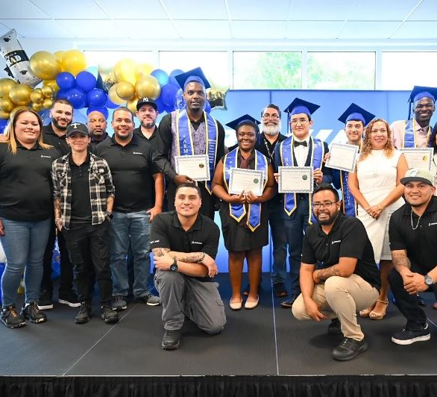

Project Search
Pairs individuals with intellectual and developmental disabilities with business internships.
valuable skills
overcome social, physical, and economic isolation
“When I first got here to Boeing, everything was new, scary and a little hard,” Ramos said.
“Eventually things got easier, and I began to learn a lot. Before I knew it, I loved coming to work here.”
Notes:
Ways to share this with your network:
2 minutes or less : Forward the article to your network : The BNN article : https://onfirstup.com/boeing/BNN/contents/38482168
5 minutes: Share this slide with your network in a team meeting or standup as a slide or handout. Talk about your key takeaway (s) from listening to the segment or reading about this story.
10-15 minutes: After the Call Resources come out share this portion of the July Call as a video in an existing team meeting
Go Deeper: research Project SEARCH using the resources below, learn about what your organization is doing to promote undertsanding of neurodoveristy and employ persons with disabilities. Seek ways to advocate for and promote disability inclusion in your sphere of influence.
Go Deeper:
The big picture: The nine-month program is a total workplace immersion that facilitates a seamless combination of classroom instruction, career exploration and hands-on training through worksite rotations.
Interns supported material handling and 5S efforts in Operations and completed three 10-week rotations in different areas. Tasks included:
Sorting and packing customer purchase orders
Unloading purchase orders from delivery trucks
Organizing boxes on shelves and repacking damaged or bulky boxes
Scanning product into bin locations
Sorting and scanning orders out of the pick tower
“What I have learned at Project SEARCH and Boeing has been important and has made me wish for more out of my future. My plans and goals are bigger than when I began here,” Ramos said. “I now feel like I can do anything and be a good employee. I still can't even believe how far I have come to be completing an internship in one of the biggest companies in the world. I will be forever grateful for this experience.”
Another intern, Tamique Malcom, is also embarking on her professional career, working full time on Sud’s team. Like Ramos, she’s also taking the next steps to become more independent by getting her driver’s license.
The Boeing Distribution team is making plans to expand the program next year and offer more internship opportunities.
Go deeper:
This Project SEARCH program is a partnership between the Miami-Dade County Public Schools, Best Buddies International and Boeing.
Best Buddies is a non-profit organization dedicated to ending the social, physical and economic isolation of the 200 million people with intellectual and developmental disabilities.
Learn more about the Boeing Employees Ability Awareness Association BRG and become a member.
Read the BNN about how Boeing recently ranked #9 on the Fair360 (formerly Diversity Inc.) list of Top 50 companies for diversity and #7 on the list for Individuals with Disabilities.
More detail :
Experiences & Takeaways
Scanning items
Quantity verification
Prioritizing dates/work/AOG
Time management skills
Handling different materials
Packaging items
Worked in 2-3 departments
Consistently clocking in and out
Calling out sick responsibly
Navigating Dayforce
Responsible for Boeing ID
CPR Certification
Booking their transportation
Making different size boxes
Using 2 scales
Change tape and add water to tape machines
Students trained and worked in different departments depending on their abilities and skills, and preferences.
Receiving
Anchoring
Pick Tower
VAS

Slide 5


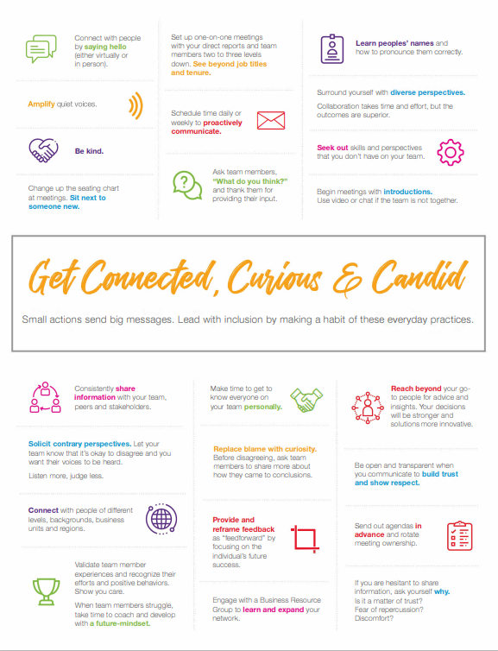
SS&L Easy Share – Inclusive Habits
5-10 min
Team Talks
Q3 2024 Inclusion by All
Click the image, then click open (or save as) to view or save the 1-page tip sheet
2) As a team, discuss:
Share a time when someone sought your input. What effect did it have on you? What about a time when you were left out of an important decision?
What actions by others have made you feel like you trust and respect each other?
How do such actions impact the quality of our work?
3) Commit to action: Pick one or two actions from the poster to commit to practicing both individually and as a team.
4) Go Deeper: Review our past discussion guide “It's About the Little Things”
Notes:
Add this nudge and link to your email signature:
Small actions matter: Get connected, curious, and candid.
Link the 1 page tip sheet with this link : https://wsso-support.web.boeing.com:2016/redirect.html?URL=https://csdms.web.boeing.com/dmswsso/getdoc?number=1540-24-01186&status=Released
Ways to share this with your network:
5 minutes: Share this slide and/or the tip sheet with your network in a team meeting or standup as a slide (or handout.) Talk about your key takeaway (s) from listening to the segment or reading about this story.
10-15 minutes: Using the tip sheet and the Team Talks Guide – discuss with your teams one or more of the questions on the slide
Go Deeper: Review our past discussion guide “It's About the Little Things” ; practice the seek, speak, & listen habits and engage in deeper conversations
Seek, Speak, & Listen Website : https://seekspeaklisten.bcs.boeing.com
3Q Team Talk Resources : https://degreed.com/articles/q3-team-talk-resources?d=42421340&inputtype=article&orgsso=boeing&inputType=Article
Inclusive Habits Tip Sheet : https://wsso-support.web.boeing.com:2016/redirect.html?URL=https://csdms.web.boeing.com/dmswsso/getdoc?number=1540-24-01186&status=Released
2024 Inclusion Ambassador Guides, Decks, Resources and Recordings : https://degreed.com/pathway/49elkmnwp5?orgsso=boeing

